Slide 1
Healthy Relationships Direct Work Tools
Involvement Team
Dan Lassey – Risk in the Community Senior Practitioner

Slide 2
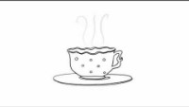
Healthy Relationships Direct Work Tools
Tea and Consent - https://www.youtube.com/watch?v=pZwvrxVavnQ

Slide 3
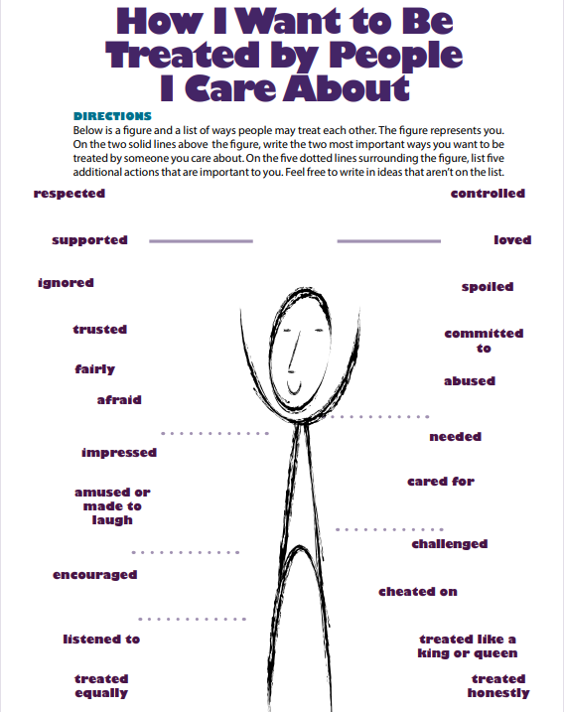
What is important to you in your relationships / what do you appreciate about your closest relationships?
What are some of the ways that people have treated you that have helped you feel good about yourself?
What are some of the ways that people have treated you that have made you feel bad about yourself?
How do you want others to treat you?
What do you think of when you think of dating?
What are some of the activities you do with someone when in a relationship with them?

Slide 4
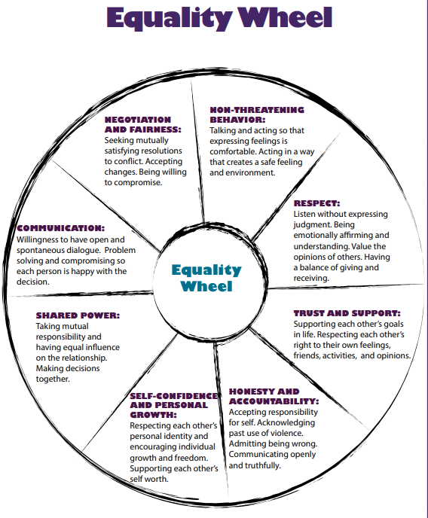
Purpose: To have young people review characteristics of a healthy relationship.
Emphasise that is equality is in the middle circle because we want to be equals in all of our relationships and that the activity looks at “How do we develop healthy relationships with people we love?”
Go through the sections on the equality wheel and ask the young person to give examples that they have experienced/ seen that demonstrate the concept or any examples that they believe would relate to the concept.
This activity provides support recognising respectful and supportive relationships and can lead to discussions around negative behaviours.

Slide 5
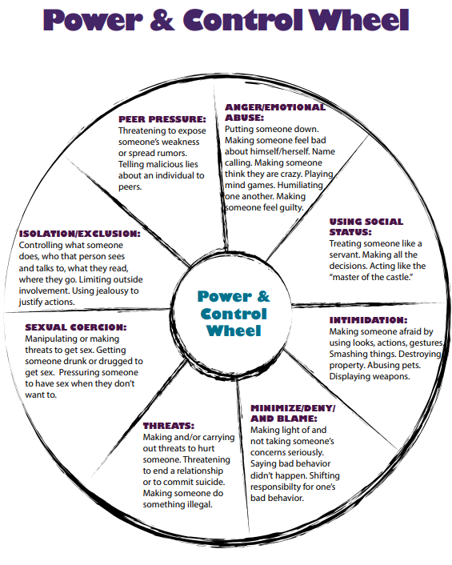
Purpose: To support young people to identify elements of an unhealthy relationship.
Begin by asking:
What comes to mind when you think of an abusive or unhealthy relationship?
What are some things that happen in an abusive or unhealthy relationship?
Next, you will show the young person the power and control wheel. Emphasise that power and control is in the middle circle because an abusive relationship occurs when one person in the relationship tries to have power and gain control over the other person.
Go through the sections on the power and control wheel and ask the young person to give examples of behaviour that they have experienced/ seen that demonstrate the behaviour named or any examples that they believe would relate to the behaviour.

Slide 6
Please see link for worksheets and additional tools to use with young people regarding healthy relationships: Healthy-Relationships-Toolkit.pdf (healthytxyouth.org)

